Slide 1
Artificial
Machine
Intelligence
Learning

Slide 2

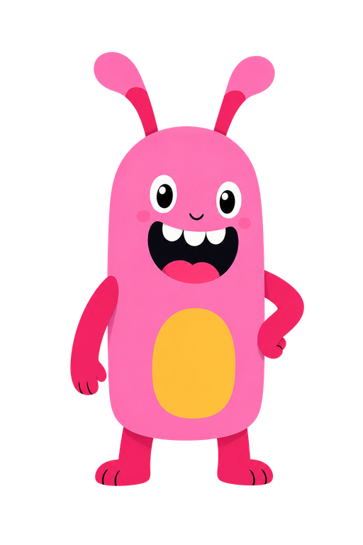

introducing...
data
BUNNIES
LILY
&
BALA

Slide 3

LILY
The Curious Analyst
Lily loves breaking....
things down and figuring out how they work. They’re logical in their approach, focused, and always asking "why?"
Species: Data Bunny
Role: Analyst/Teacher

Slide 4

BALA
The Energetic Helper
Bala loves building....
anything and everything they can get their hands on. They turns chaos into construction and do it all with passion.
Species: Data Bunny
Role: Builder/Teacher

